Slide 1

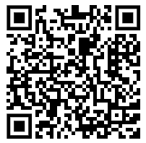
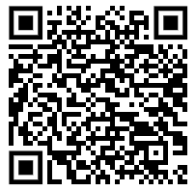

Got questions about retirement?
Whether your retirement is a long way off or just around the corner, it’s never too early or too late to get started with planning. A little time and some small actions today could make a big difference to your tomorrow.
Come along to our ‘Your path to retirement’ session where we’ll cover the most popular questions our members ask on this topic and share simple steps you can consider to help you stay on track for a great retirement.
Uniting Church Super Plan
Register for Your path to retirement Webinar
When: Wednesday, 12 November, 2pm AEST
Where: Virtual Zoom
Book in for a Super Check Appointment
When: Every Monday
Where: Virtual Appointment
This communication has been prepared by Mercer Outsourcing (Australia) Pty Ltd (MOAPL), ABN 83 068 908 912, Australian Financial Services Licence #411980 as the administrator of the Mercer Super Trust ABN 19 905 422 981. Mercer Superannuation (Australia) Limited (MSAL) ABN 79 004 717 533, Australian Financial Services Licence #235906 is the trustee of the Mercer Super Trust. Any advice provided is of a general nature and does not take into account your objectives, financial situation or needs. Before acting on any advice, please consider the Product Disclosure Statement available at mercersuper.com.au. The product Target Market Determination can be found at mercersuper.com.au/tmd 'MERCER’ is an Australian registered trademark of Mercer (Australia) Pty Ltd ABN 32 005 315 917. Copyright ©2025 Mercer. All rights reserved.
A business of Marsh McLennan

