Slide 1


February 2025 - God's story – Our story

Slide 2
The agenda today includes:
Proposals coming to Synod in Session
The new PSU
Safe Church Update, and
Discipline in the Church

Slide 3
At Synod in Session in May the following papers will be proposed -
1 Renewal and Growth Strategy 2025 – 2028
2 Church Renewal Fund, Covenant Ministry Fund and Property
Sale Proceeds Policy
3 Church Planting & Revitalisation Strategy

Slide 4
2025-2028: Our Foundations for Renewal and Growth
We are one church active in every Queensland community, bearers of Christ's offer of life in all its fullness. Through our shared life we are committed to a flourishing future for church and community.
Mission Renewal and Growth
Flourishing Presbyteries
Forming Leaders
Fit for Purpose Governance
Stewarding Resources
We will accompany the Church, supporting renewed discipleship, new growth and missional development.
We will deepen our covenant with the UAICC and advocate and act for Social Justice for all
We will co-create plans to support Presbyteries, developing new approaches to shared and delegated responsibilities
We will embed, build, and optimise the Synod’s leadership principles and pathways, and develop emerging leaders across Queensland
We will improve whole of church governance processes and structures, implement governance review outcomes for institutions, and develop the capability of governing bodies and councils of the Church
We will steward our resources and innovate and diversify funding sources to improve financial sustainability for the Office of the Synod and the wider Church in Queensland

Slide 5
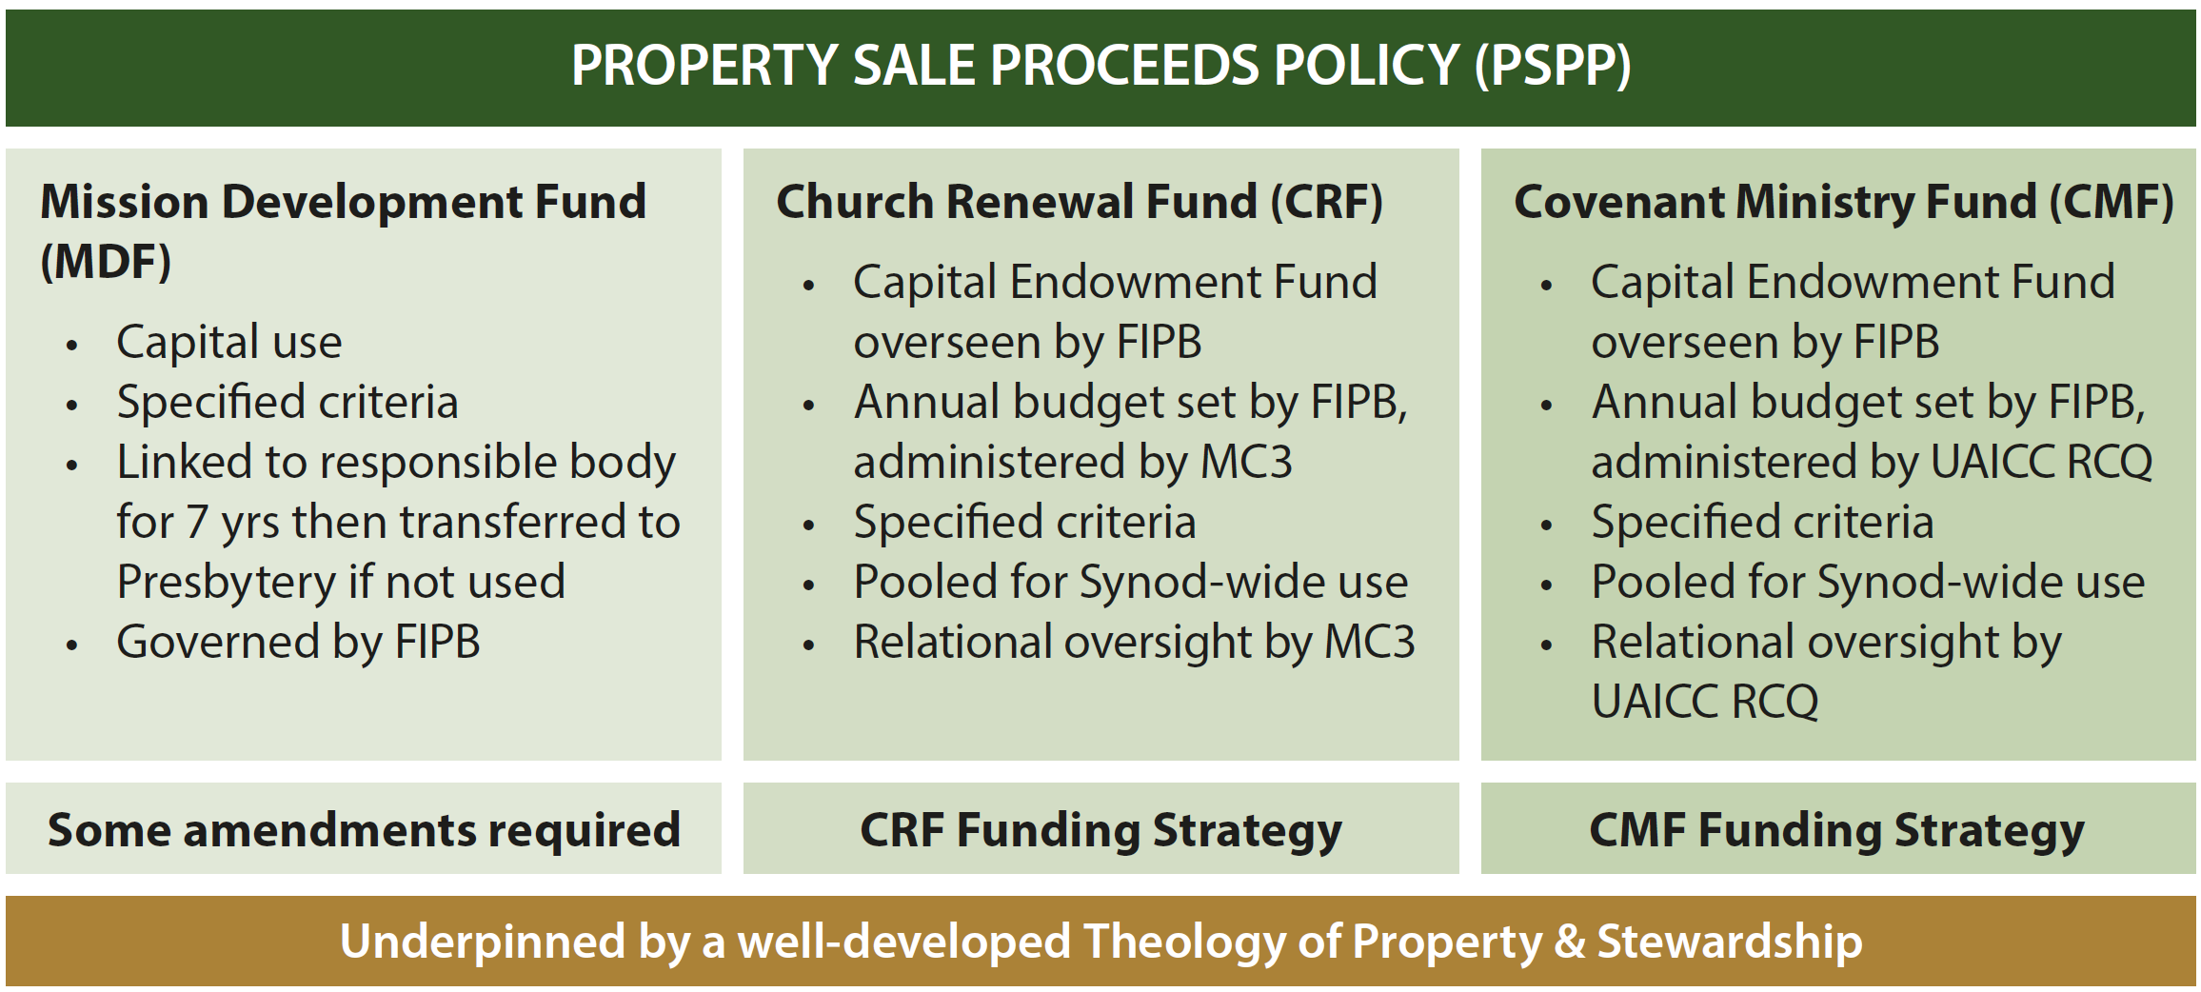
2. Two new funds are being proposed, the Church Renewal Fund,
and Covenant Ministry Fund
Notes:
You may recall from the last Presbytery meeting that the Synod Office, through prayerful discernment, identified the need for Mission Renewal and Growth, and Stewarding Resources. To support these, we propose two new funds: the Church Renewal Fund and the Covenant Ministry Fund. These funds will be built through strategies like creating property sale proceeds policy and fundraising, all underpinned by a Theology of Property and Stewardship. This approach aims to pool finances across the Synod with relational oversight and accountability.

Slide 6
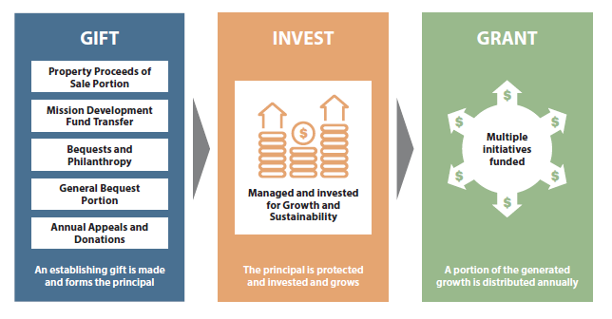
How the funds work -
Notes:
To bring these funds to life, gifts are made which form the principal of the fund, the gifts are invested and grow, then a portion of the generated growth is distributed annually.
We are thankful to the presbyteries for their survey responses received about the proposed Church Renewal Fund, Covenant Ministry Fund and Property Sale Proceeds Policy in the November presbytery meetings.
The results showed there is very strong support, we received valuable feedback and incorporated the themes that emerged in further developing the Proposal.
The final paper is nearing completion and will be included for the 38th Synod in Session and there will be opportunities for you to ask questions in the lead up to the 38th Synod.
In the meantime, if you have burning questions, please contact Kylie Sessa on kylie.sessa@ucaqld.com.au.

Slide 7
Building a Garden
Congregations/Faith Communities
Presbyteries
Synod
Seek and pursue opportunities
Train & implement plants/revitalisation
Identify, support & train leaders & teams
Vision & Imagination
Identify opportunities
Train and support leaders & teams
Approve, monitor, oversight
Facilitate training, coaching and support
Regional planning & strategy
Inter-congregation partnerships
Foster innovation and experimentation
Resourcing and property options
Encourage & practice collaboration
Generate passionate commitment
Partner with Presbyteries
3. Church Planting &
Revitalisation
Strategy
Notes:
The 38th Synod will consider endorsing a Synod approach to help build and embed a culture of church planting, replanting and renewal. The Synod will be asked to join presbyteries and congregations already at work in this area, helping to foster a Synod-wide effort over an extended period. This proposed strategy is consistent with the Synod’s focus on renewal.
Imagine, if you will, the shared work of planning, planting and nurturing a garden. There are so many tasks required to plan, plant and tend to a healthy garden – and this metaphor might help us understand the work of the Synod as it contributes alongside that of congregations, faith communities and presbyteries.
Congregations and faith communities seek and pursue opportunities, identify and support leaders, make brave and bold decisions, partner with their presbyteries and do the hard day-to-day work of planting, replanting and renewal. They are all about the seedlings and fresh shoots.
Presbyteries encourage and identify the pursuit of opportunities, train and support leaders and teams, help guide church plants and replants through approval and regulation, provide regular support and encourage inter-congregational partnerships. They are all about tilling the soil, and planting the garden and fertilizing the fresh seedlings.
The Synod will consider an approach in which it works together with presbyteries, collaborating to facilitate training and coaching of teams and leaders, encouraging and enabling innovation and experimentation, sourcing and releasing resources, and helping unearth a passionate commitment. The Synod will be all about the tools used in the garden, about sharing ideas between different gardeners, and about the stakes and trellises that allow plants to be healthy.
God has been at work, over a long period of time consistently and persistently calling our church back to the work of planting and replanting, of making and being disciples. We’ve heard that through our Vision for Mission nearly 20 years ago, in an open space Synod meeting 10 years ago, and loudly in our Project Plenty consultations six years ago. Congregations and presbyteries have heard the same call and got on with the job. This proposal will invite the Synod itself to take up the tools and do it’s share of the work of planning, planting and growing.
The proposal and supporting notes will be available to Synod members in March. It’s been developed based on feedback from the discussion paper released last November, from Presbyteries and congregations already engaged in church planting, replanting and renewal. I commend it to you.

Slide 8
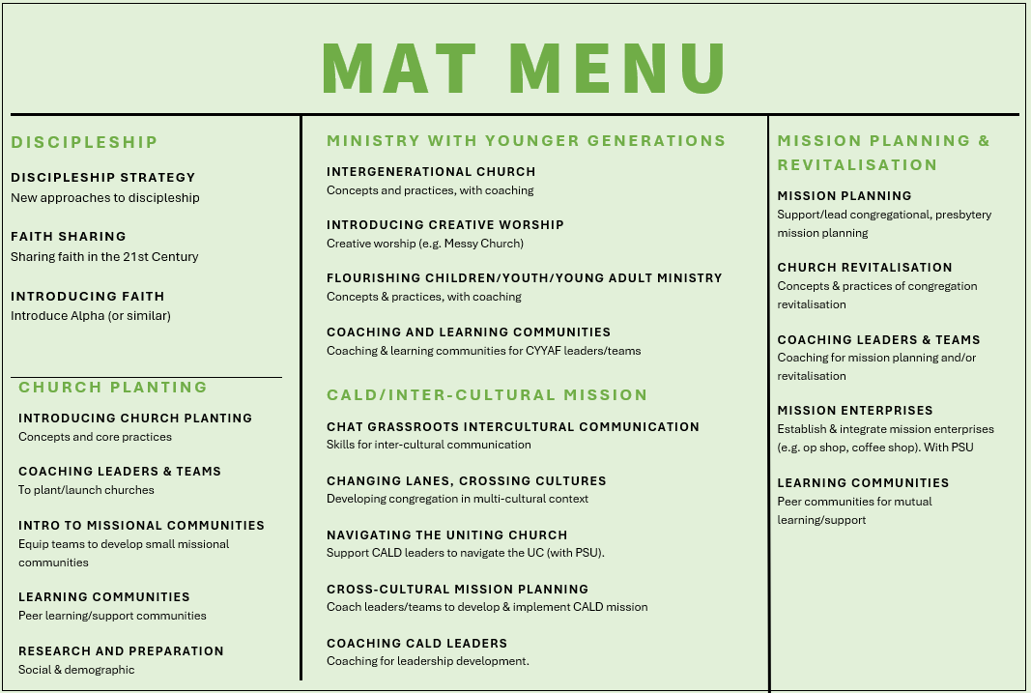

Lent Resource
Contact: hi-mat@ucaqld.com.au
Notes:
Brief update on the activities of the Synod’s Mission Accompanying Team.
As you know, established late 2024, and the team exists to support and accompany congregations, faith communities and presbyteries in elements of mission. The Team consists of practitioners – people active in congregations and faith communities across the state, and mainly part time. They have experience in discipleship, missional communities, community engagement, church planting, leadership development, cross-cultural ministry and engaging younger generations.
New additions to the team since the last presbytery meeting incl Rev Marius Kruger and Malcolm Scanlan. Both Marius and Malcolm are part-time with MAT and continue their other ministry at Highfields and Wesley Mission Queensland respectively. They join Adam Legge, Jess Pinkerton, Faye Talatonu, Ralph Mayhew, Paul Clark, Netani Bolatolu and Scott Guyatt
Three things we want you to know about:
Currently developing a MAT Menu – a simple listing of the ways in which people from within the Mission Accompanying Team are ready to work with you.
Lent resource – available 20/2, resources for congregations, families, community groups to explore Lent
Intercultural ministry report – to be released at 38th Synod, explores the current state of our CALD and multicultural congregation

Slide 9
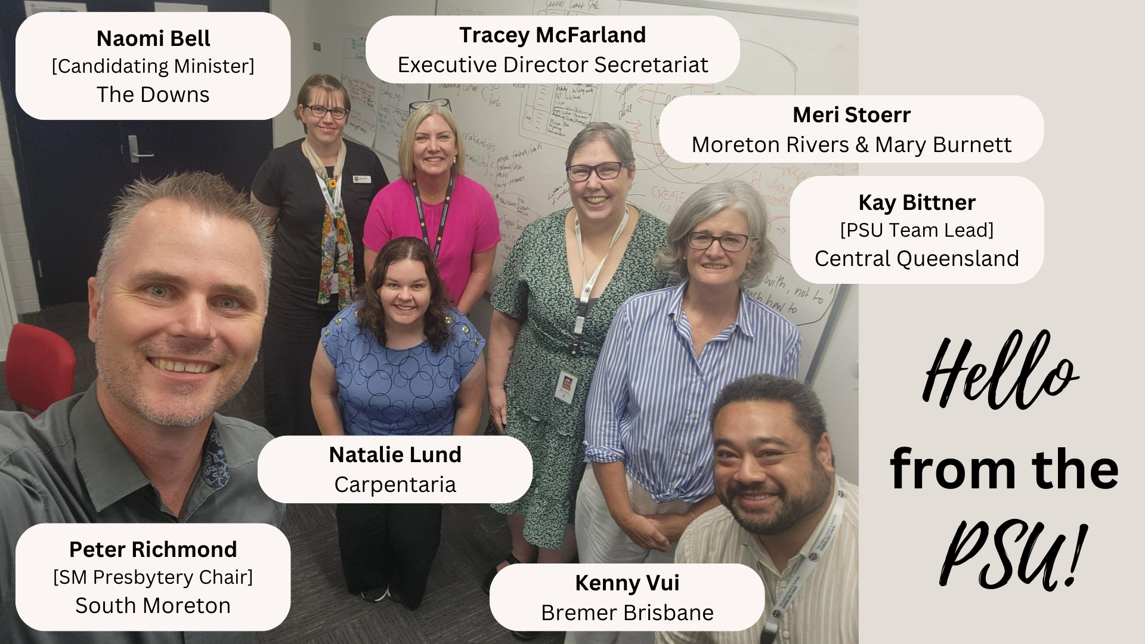
The new PSU (Presbytery Support Unit)
What is the Presbytery Support Unit?
The Presbytery Support Unit (PSU) is a recently established team to support the growth and renewal of Flourishing Presbyteries by strengthening collaboration between congregations, presbyteries, and the Synod.
How do they help?
The PSU is here to lighten the burdens of administration, governance, Safe Church, compliance, finance and property.
How to contact the PSU
Please reach out to the PSU with any requests, suggestions, or questions by emailing:
presbyterysupportunit@ucaqld.com.au

Slide 10
Why would you contact us?
Change Champions | Knowledge Navigators | Service Supporters
Collaborate on refining/ improving services and systems. Current example is Safe Church. | Keep calling your regular people in the Synod Office. Alternatively, if you are unsure who to ask, reach out to PSU. We will answer or connect you to the expert. | Currently PSU is the UCare expert and looking to introduce a provider for congregational web sites.

Slide 11
Safeguarding/Safe Church - Update
Thank you for persevering with Safe Church training and records management
We acknowledge the challenges in accessing training materials and records, we are collaborating to improve accessibility for a smoother experience
Training materials are being relocated from edUCate to The Hub April 2025
Communication and support will be provided to facilitators to assist with the transition
Safe Church is expanding to include vulnerable people, and the new framework will be known as Safeguarding.
Notes:
There have been various iterations of Safe Church policies, materials and training in the last 10 years.
Recent changes in the safeguarding field generally and in legislation mean we need to make further changes. This is a heavily regulated area of community life and one that is important to our mission.
The Safe Church policy was changed in 2024 to expand its focus from child safety only, to include safety for vulnerable people.
Now it’s time for a more significant review of how we manage safeguarding throughout the Synod.
We intend to include a review and update of our training regime later in the process.

Slide 12
Q & A

